Slide 1
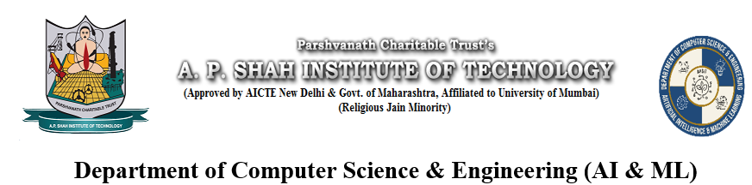
Smart Attendance System
Jay Thakare: 23106052
Sneha Utekar: 23106116
Saanj Shetty:23106070
Divya Patil:23106124
Project Guide – Prof. Shraddha Dalvi
ACADEMIC YEAR 2024-25

Slide 2
Outline
Introduction
Literature Survey of the Existing Systems
Limitations of the Existing Systems
Problem Statement
System Design
Technologies and Methodologies
Implementation Screenshots
Conclusion
References

Slide 3
Introduction
Attendance tracking is crucial in academic and professional settings.
Traditional methods are time-consuming and prone to errors.
A smart attendance system enhances efficiency using face recognition and QR code scanning.

Slide 4
Literature Survey of the
Existing System
Title | Author | Description
Real-Time Smart Attendance System using Face Recognition Techniques (2019) | Shreyak Sawhney, Karan Kacker, Samayak Jain. | The paper presents a real-time attendance system using face recognition to automate and enhance accuracy. It captures student images, processes them with deep learning models, and updates the database, reducing time and preventing fraud.
A Students Attendance System Using QR Code (2014) | Fadi Masalha, Nael Hirzallah | The paper presents a digital attendance system where students scan a unique QR code to mark their presence. The system automates attendance tracking, reduces manual errors, and ensures accuracy by integrating QR code scanning with a database for real-time updates.

Slide 5
Title | Author | Description
Development of Attendance Monitoring System with Artificial Intelligence Optimization in Cloud (2021) | Mohamad Fakir Naen, Muhamad Hariz Muhamad Adnan, Nurul Adilah Yazi, Chee Ken Nee | This paper discusses an AI-powered attendance system using face recognition and QR scanning, integrated with cloud computing for better efficiency and scalability. It overcomes issues like proxy attendance and inefficiency in traditional methods by ensuring accurate and automated tracking.
Smart Classroom Automation: A Fusion of AI with Voice, Gesture, and Face Recognition Attendance System (2024) | Md Raihan Khan, Abdullah Al Ahad, Airin Akter Tania, Tithi Das | This paper presents a smart classroom automation system using AI-driven voice, gesture, and face recognition for attendance tracking and device control. It enhances efficiency, accuracy, and security, reducing manual effort and creating a more interactive learning environment.

Slide 6
Limitations of Existing Systems
High dependency on manual input.
Lack of multi-technology integration.
Limited usability within specific ranges or environments.
Vulnerable to proxy attendance or data breaches.

Slide 7
Problem statement
To develop a smart, secure, and efficient attendance system which combines face recognition, QR code scanning, and GPS technology for added precision and accessible only within a predefined radius.

Slide 8
System Design
User authentication.
Face recognition for verification.
QR code scanning for attendance marking.
GPS radius check for location validation.

Slide 9
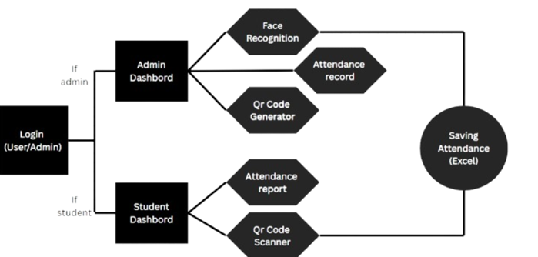
Block Diagram

Slide 10
Technologies and Methodologies
Technologies Used:
Python 3.21
QR Code scanning .
GPS .
Database:
MySQL 9.1 for user credentials and attendance records.

Slide 11
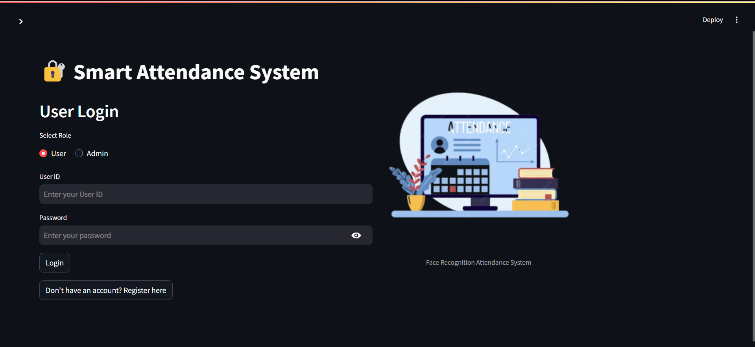
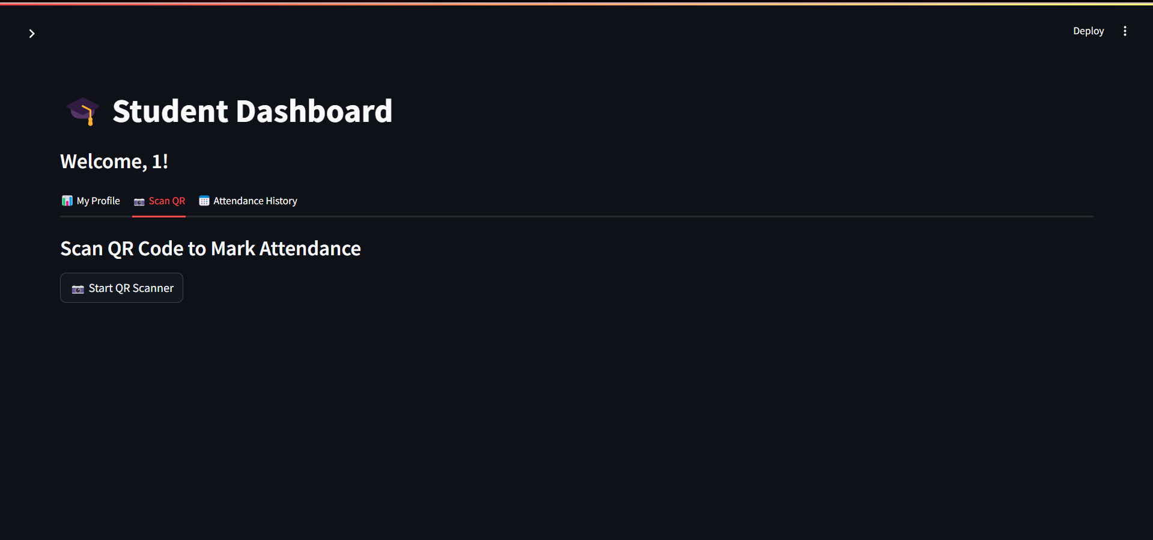
Implementation

Slide 12
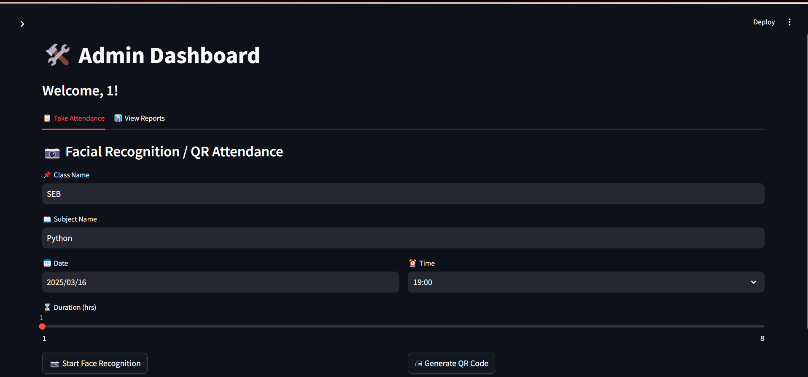
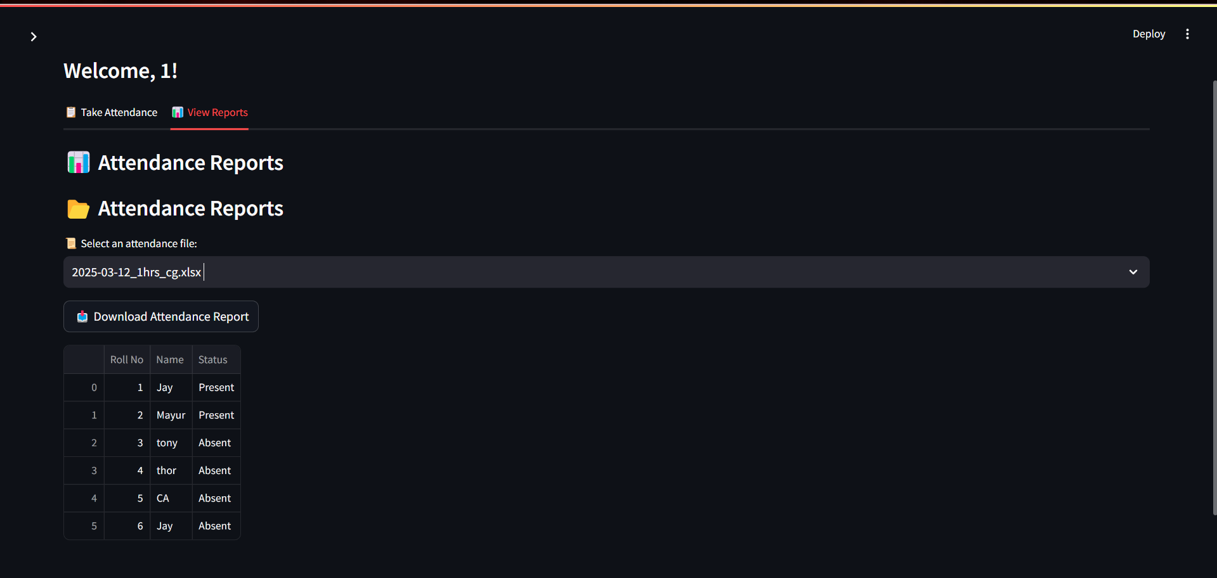

Slide 13
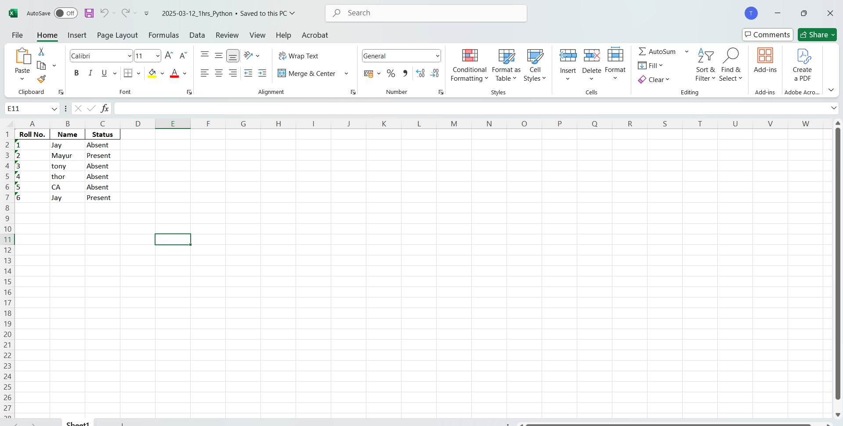

Slide 14
Conclusion
The system ensures secure, efficient, and reliable attendance management. Combines advanced technologies for multi-level verification. Reduces manual effort and minimizes errors.

Slide 15
References
[1]‘Real-Time Smart Attendance System using Face Recognition Techniques’ by Shreyak Sawhney,Karan Kacker,Samayak Jain,IEEE,Noida India ,July 2019.
[2] ‘A Students Attendance System Using QR Code’ by Fadi Masalha,Nael Hirzallah, International Journal of Advanced Computer Science and Applications (IJACSA),2014.
[3]‘Smart Classroom Automation: A Fusion of AI with Voice, Gesture, and Face Recognition Attendance System’by Md Raihan Khan,Abdullah Al Ahad,Airin Akter Tania,Tithi Das,IEEE,2024.
[4] ‘Development of Attendance Monitoring System with Artificial Intelligence Optimization in Cloud’ by , Mohamad Fakir Naen,Muhamad Hariz Muhamad Adnan,Nurul Adilah Yazi,Chee Ken, International Journal of Artificial Intelligence,2021.
[5] ‘Think Python’ by Allen B. Downey, 2002.
[6] ‘Learning SQL’ by Alan Beaulieu,2005.

Slide 16
Thank You...!!

